Slide 1
The Early Ruskin Manuscripts, 1826-1842
An Electronic Archive

Slide 2
Aims of this presentation
To summarize the editorial rationale and methodology of the edition, Early Ruskin Manuscripts
To explain our solutions for adapting XML encoding and the standards of the Text Encoding Initiative (TEI) in order to describe the special features of the early Ruskin manuscripts
To demonstrate the resulting design of the electronic archive, and to ask your response
To present an example of the kind of scholarship that can be opened up by this new editing of the early Ruskin

Slide 3
History of the project
Archival study (1990s): transcription and bibliographical description and analysis of early manuscripts.
Development of a Digital Humanities project at Southeastern Louisiana University (earlier 2000s).
Program development through partnership of Ruskin project with Book of Margery Kempe project (later 2000s).

Slide 4
History of Editing the Early Ruskin and the Editorial Rationale of ERM
Two historical contexts of editing early Ruskin, 1850-1900
Familial preservation of the early career
Late Victorian book collecting and the interest in juvenilia and youthful writing of modern authors
Contest between these aims and constituencies in late Victorian editing and bibliography of the early Ruskin

Slide 5
Plan of the Archive
Works, Manuscripts, and Corpora
Works
Apparatus Page (information about available Witnesses, Title, Genre,
Witnesses (transcripts, annotation, facsimiles)
Manuscripts
Apparatus Page
Commentary
Notes (hyperlinked universally)
Annotation (hyperlinked to Works transcriptions only)

Slide 6
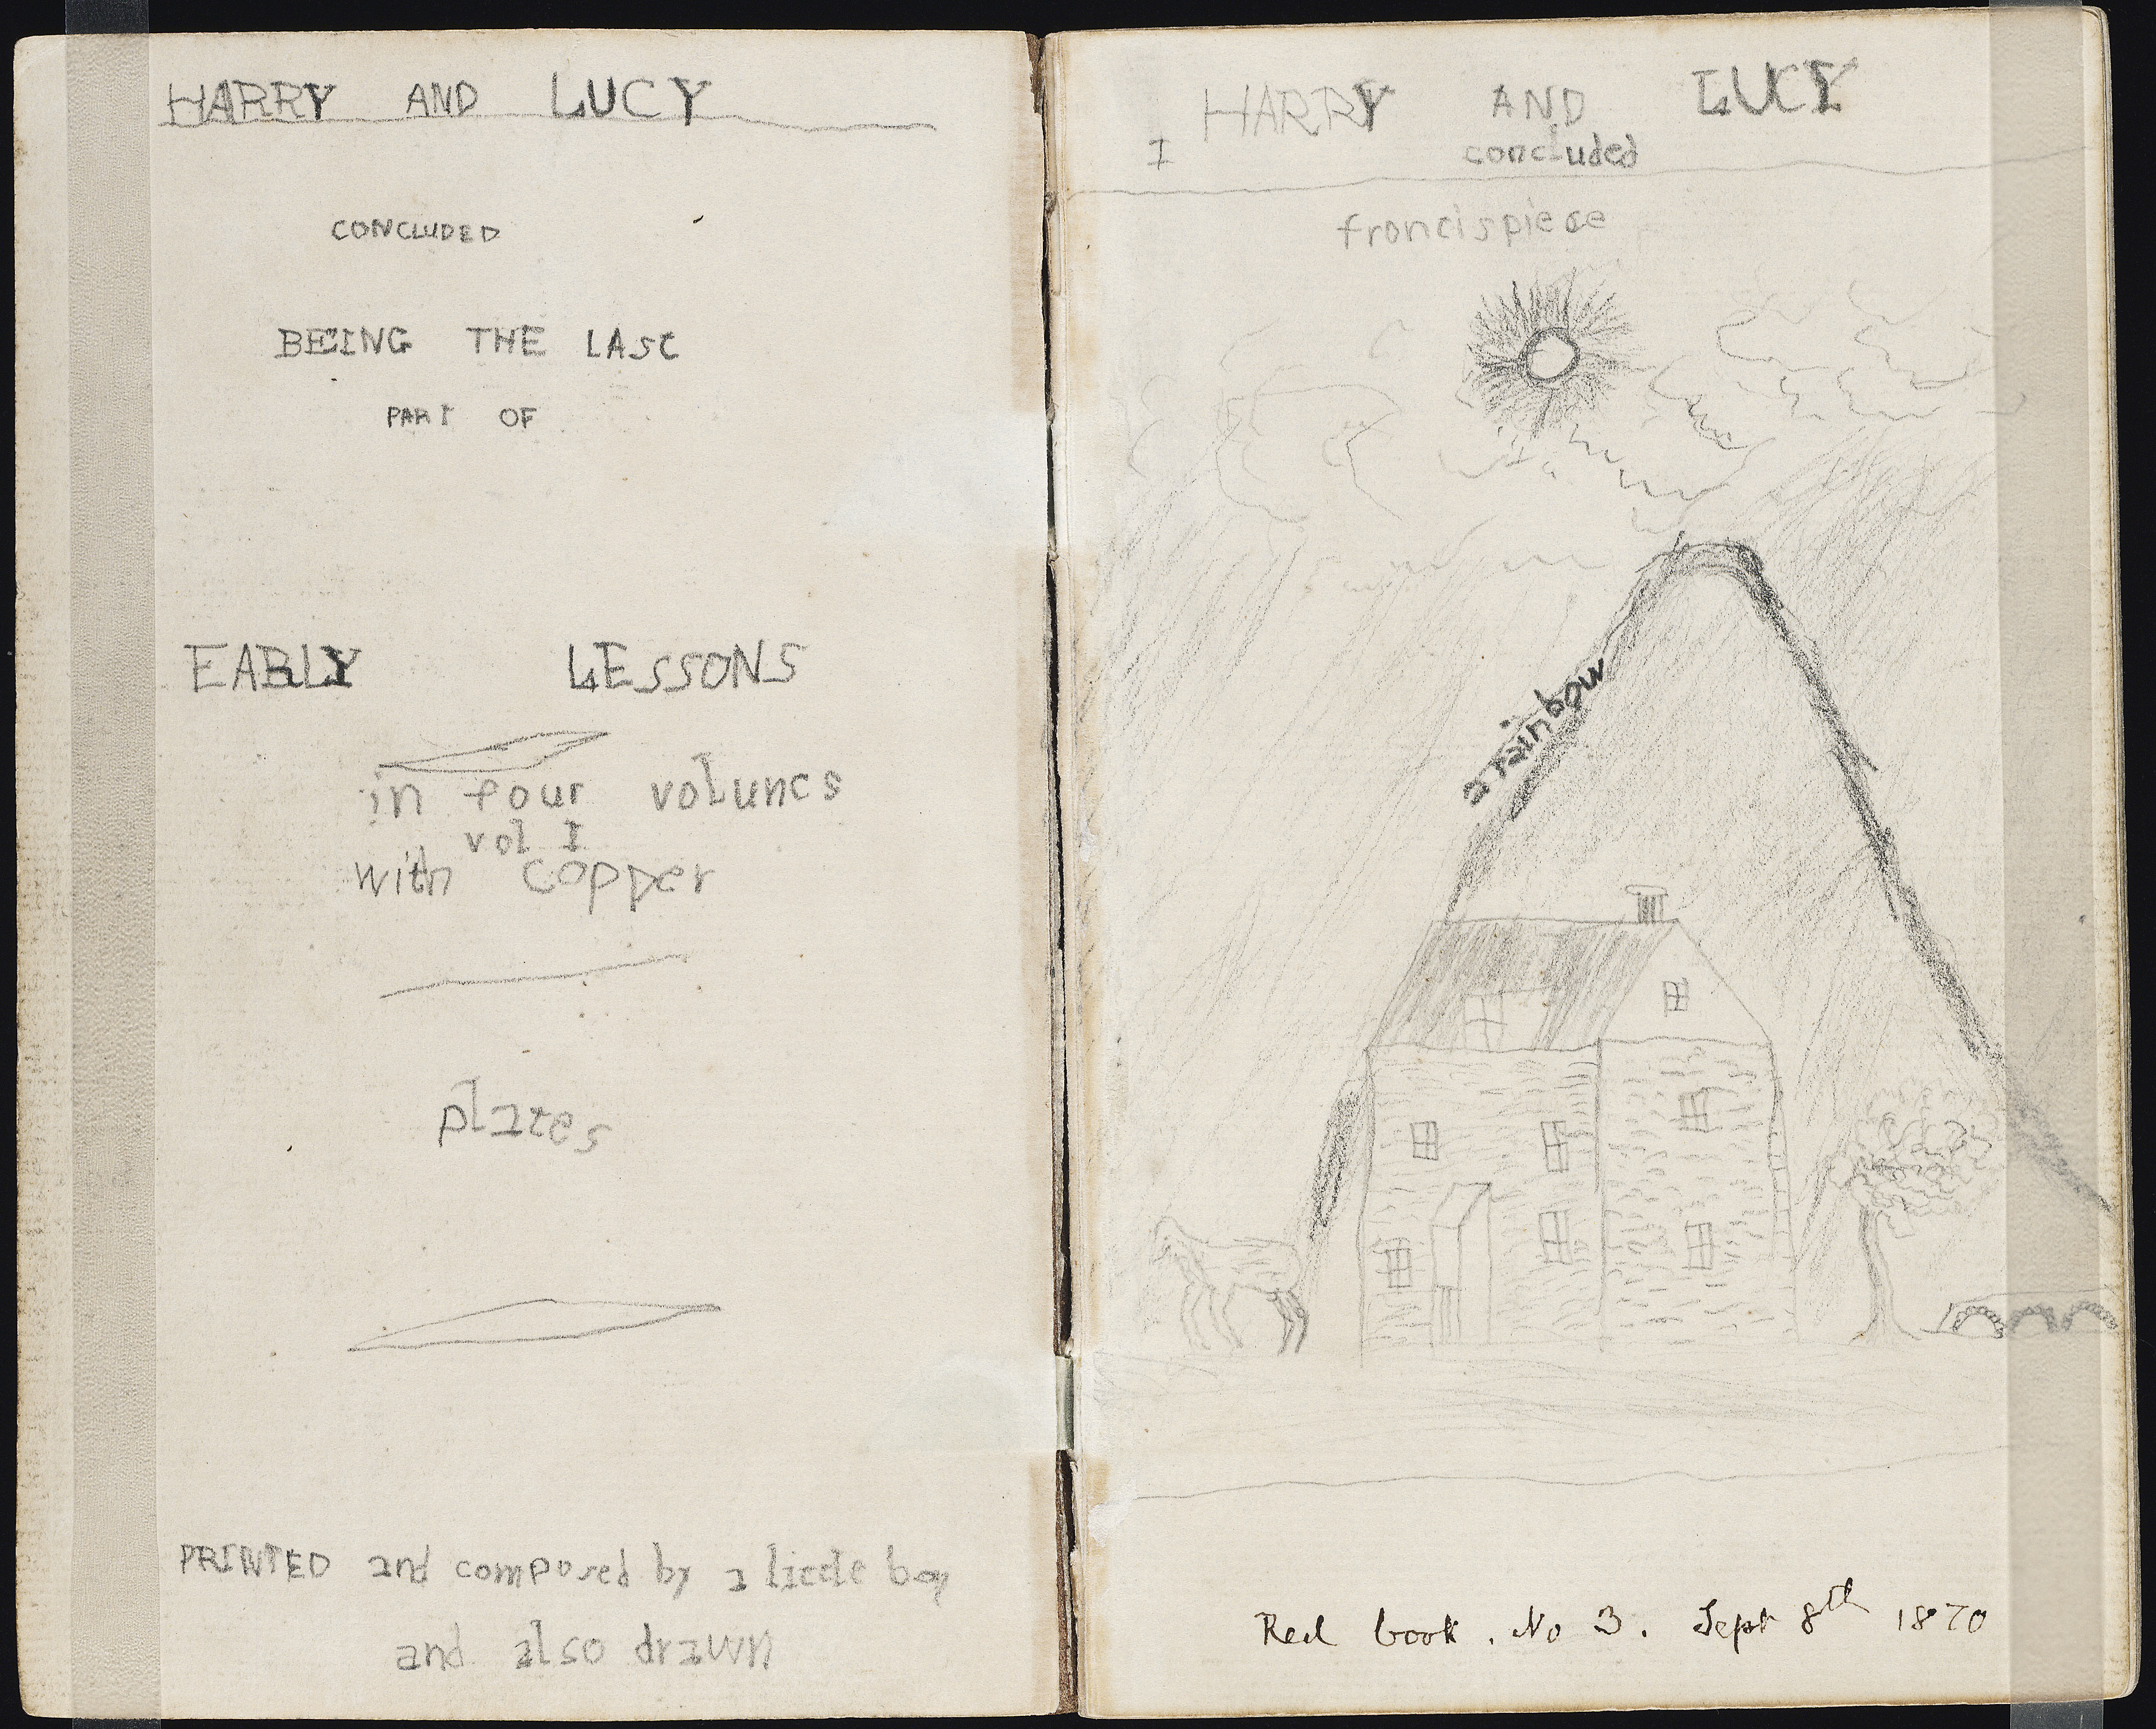
Title page, MS I

Slide 7
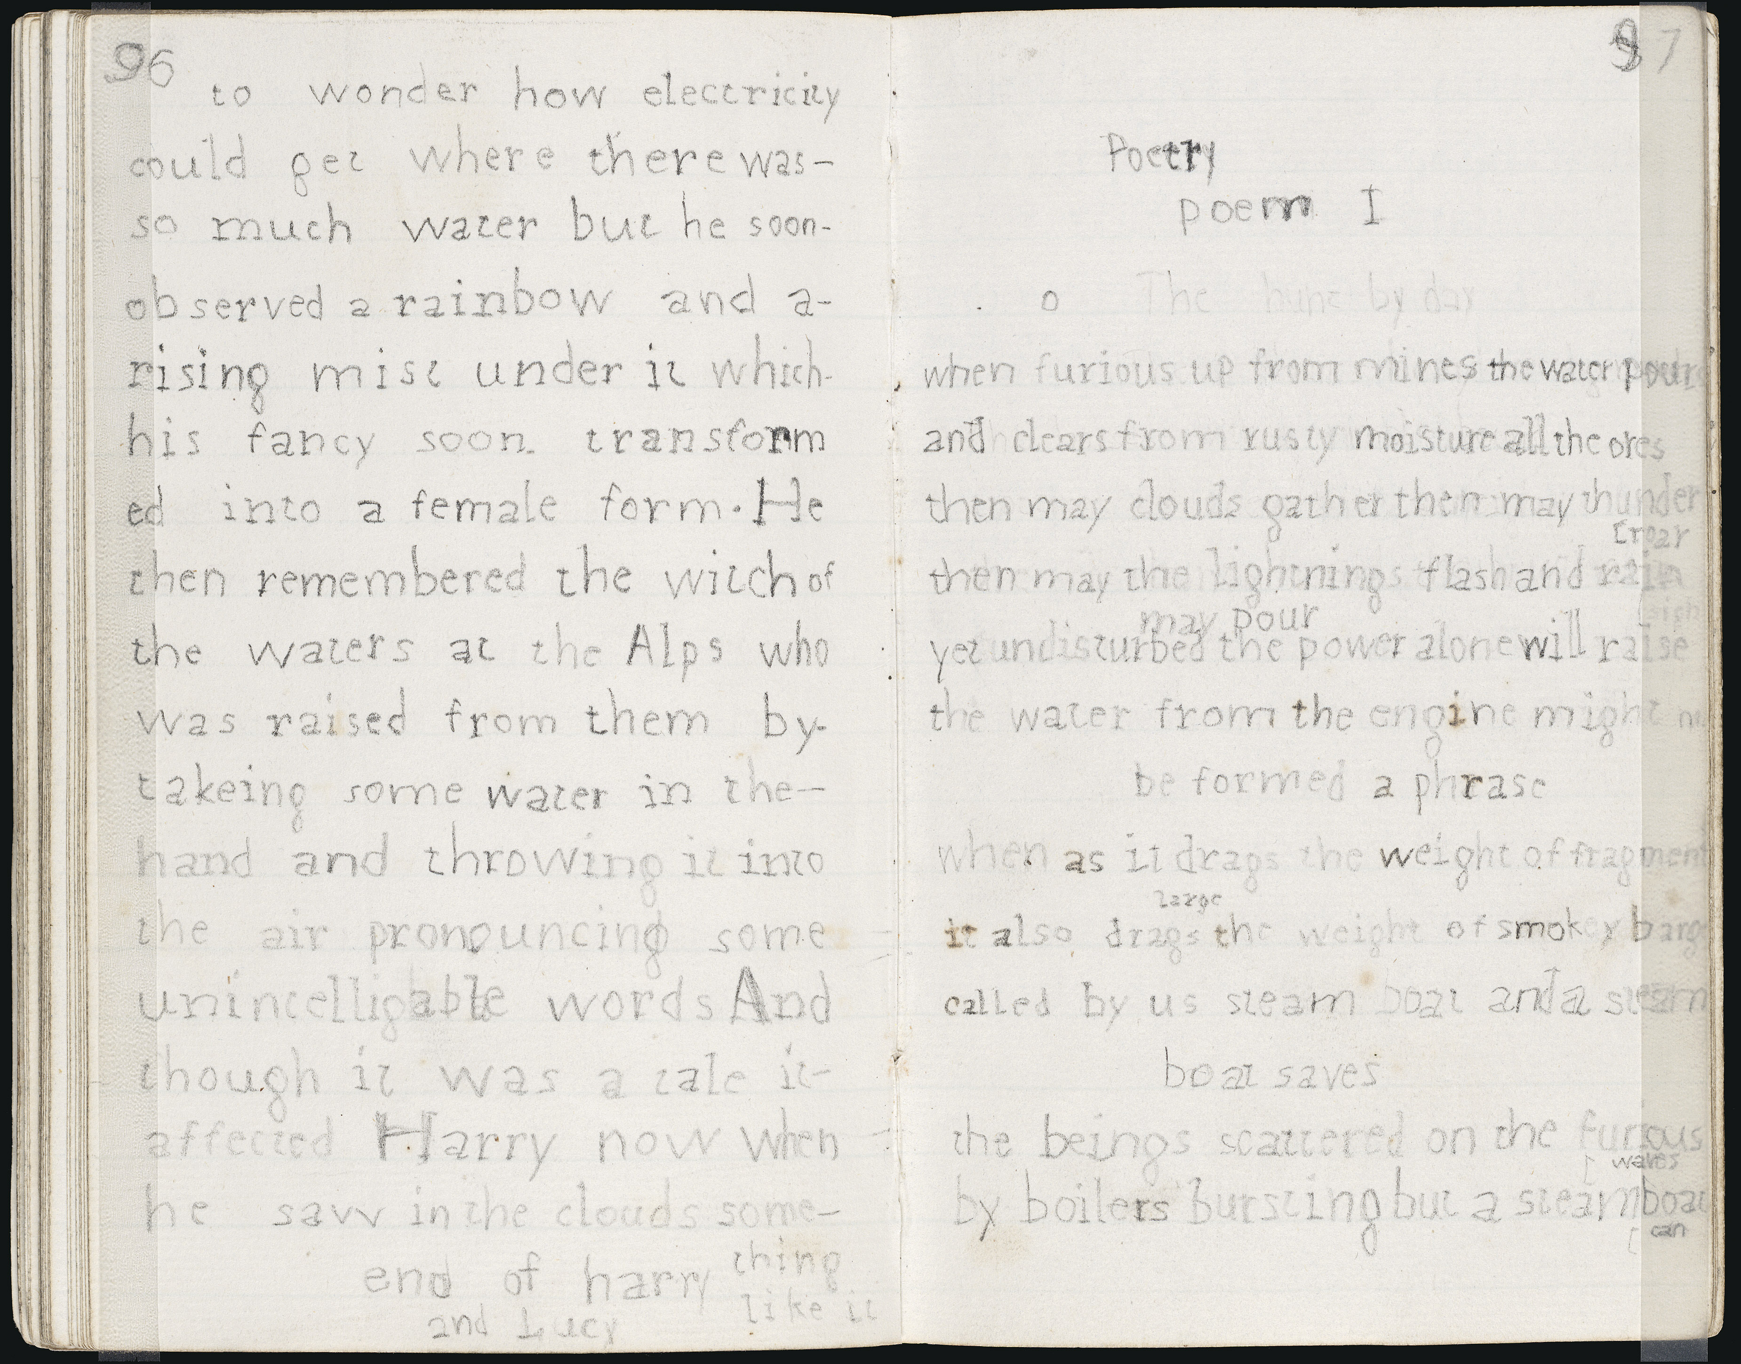
MS I Poetry Anthology

Slide 8
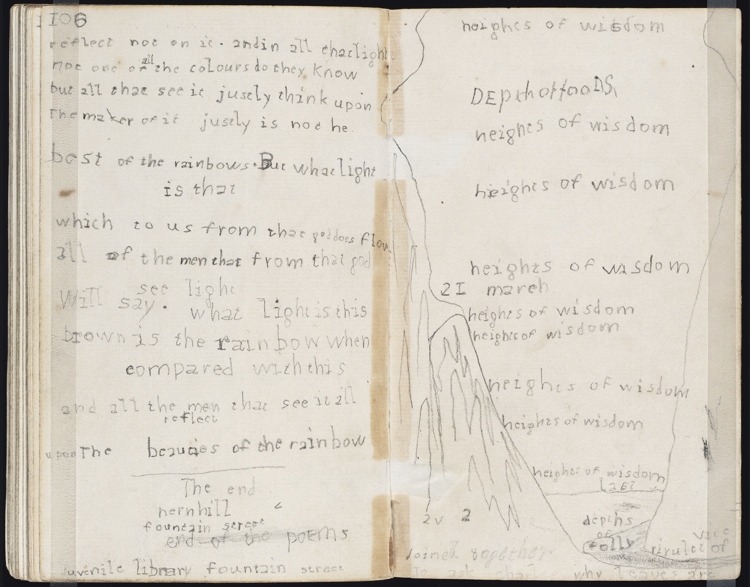
MS I colophon

Slide 9
Group versus Corpus
Valid use of TEI element <group>
<group>
<text>
<!-- first poem -->
</text>
<text>
<!-- first poem -->
</text>
</group>

Slide 10
Group versus Corpus
Invalid use of TEI element <group>
<group1>
<!-- vol. 1 “Early Lessons” -->
<group2>
<text>
<!-- first poem -->
</text>
<text>
<!-- first poem -->
</text> <group2>
</group1>

Slide 11
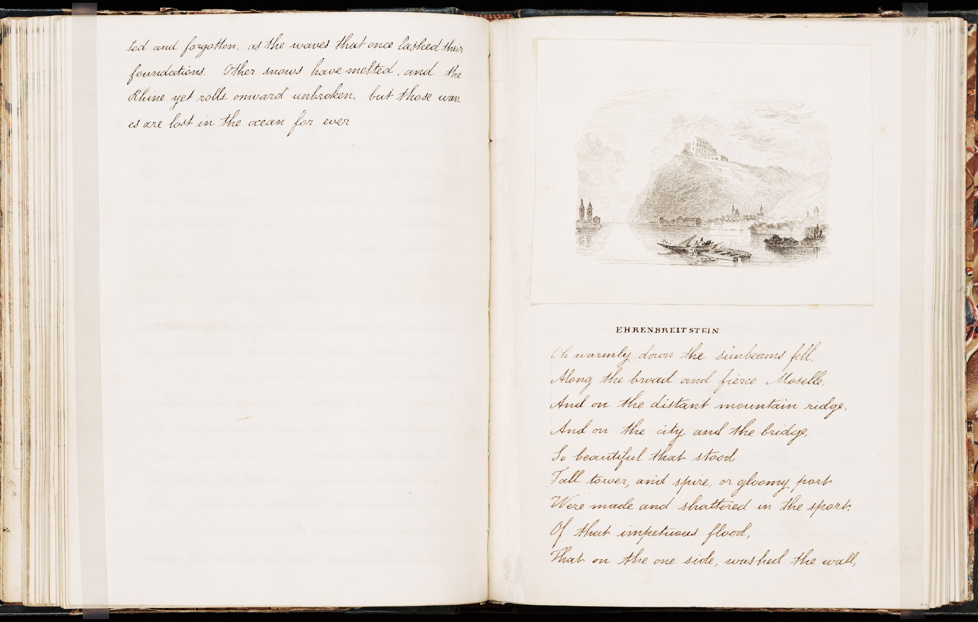
“Ehrenbreitstein,” Account of a Tour on the Continent, MS IX

Slide 12
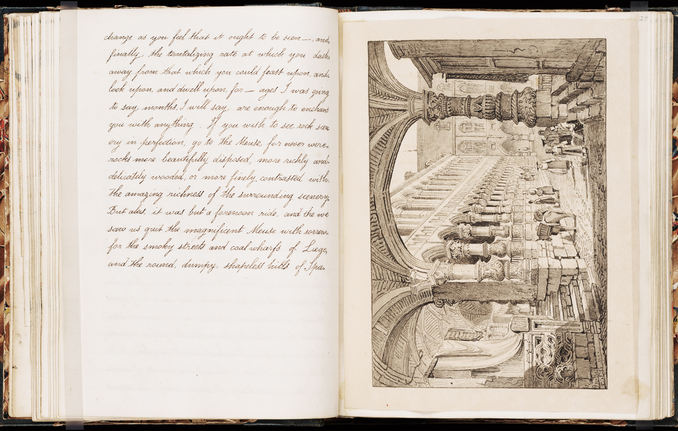
“Liege,” Account of a Tour on the Continent, MS IX

Slide 13
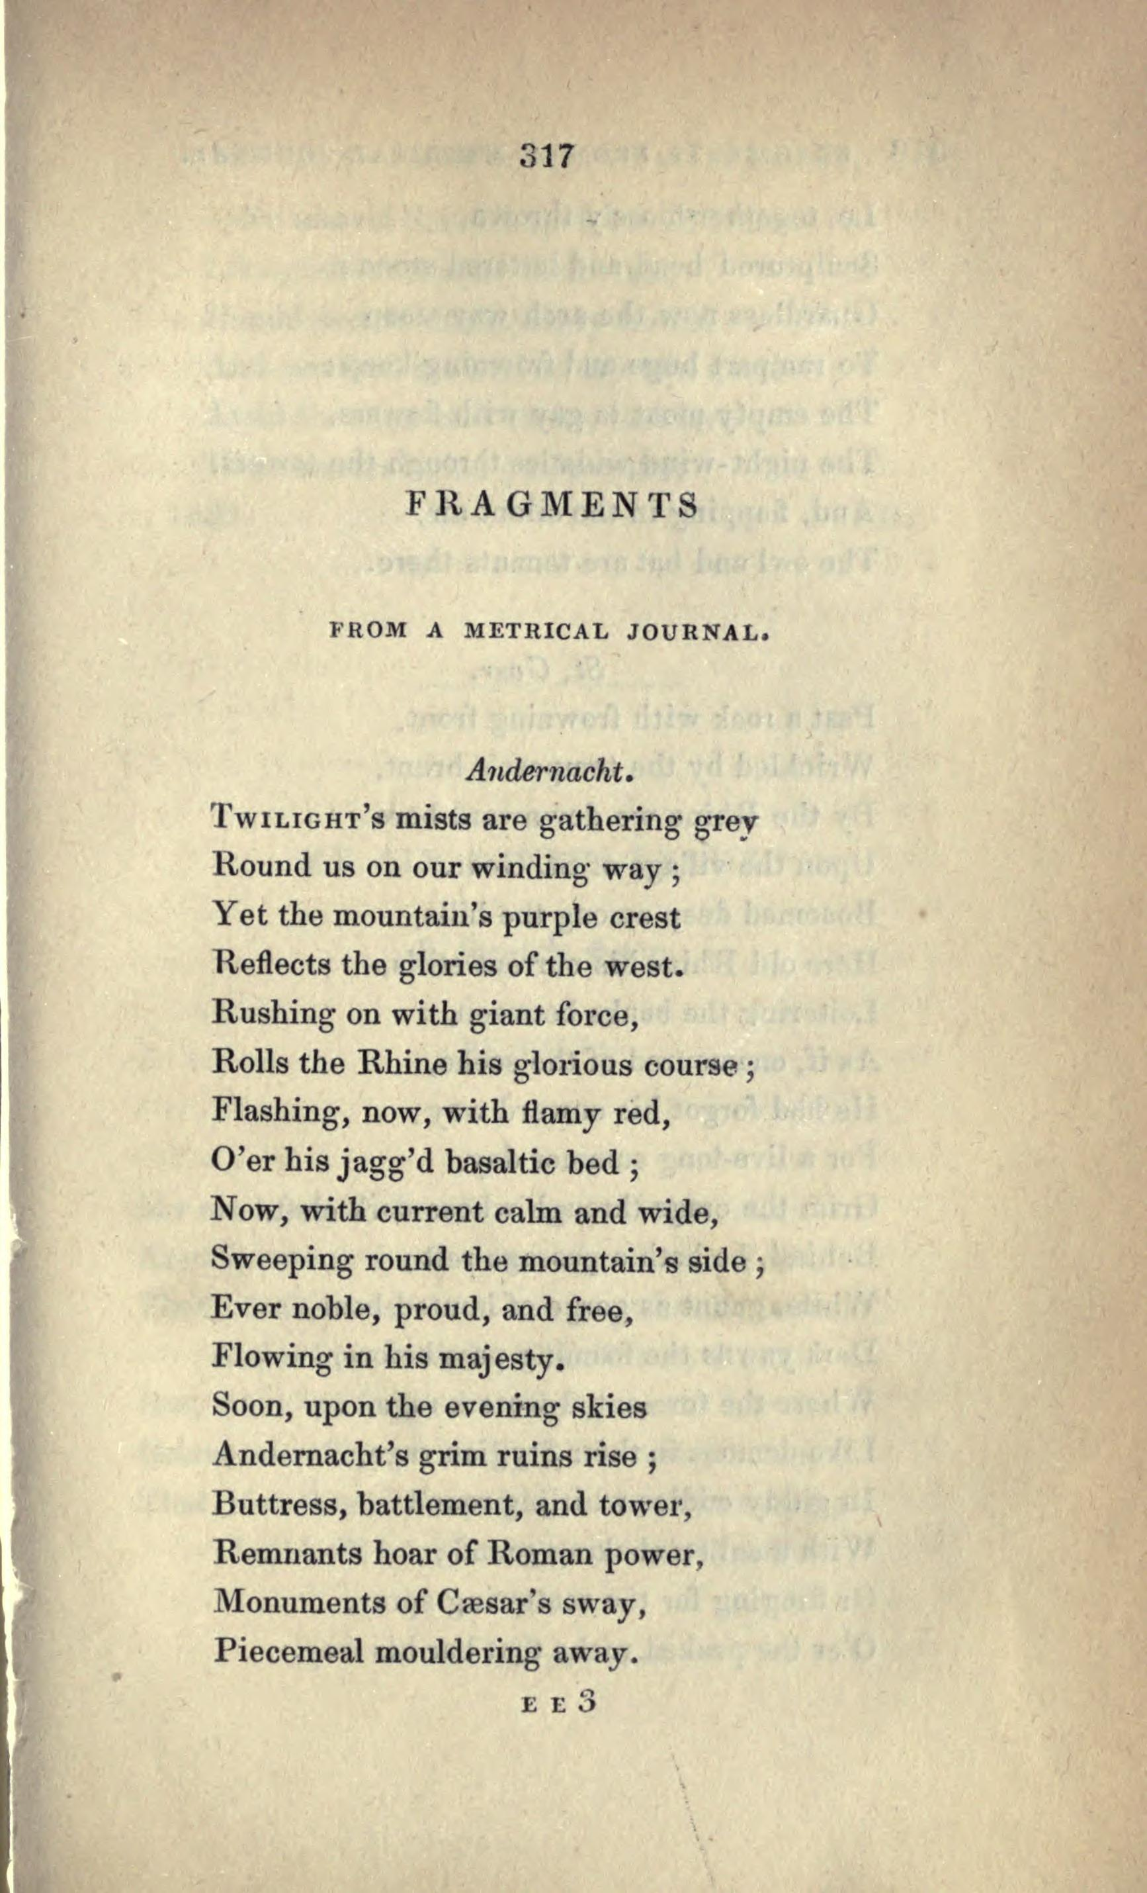
J. R., “Fragments from a Metrical Journal,” Friendship’s Offering (1835)

Slide 14
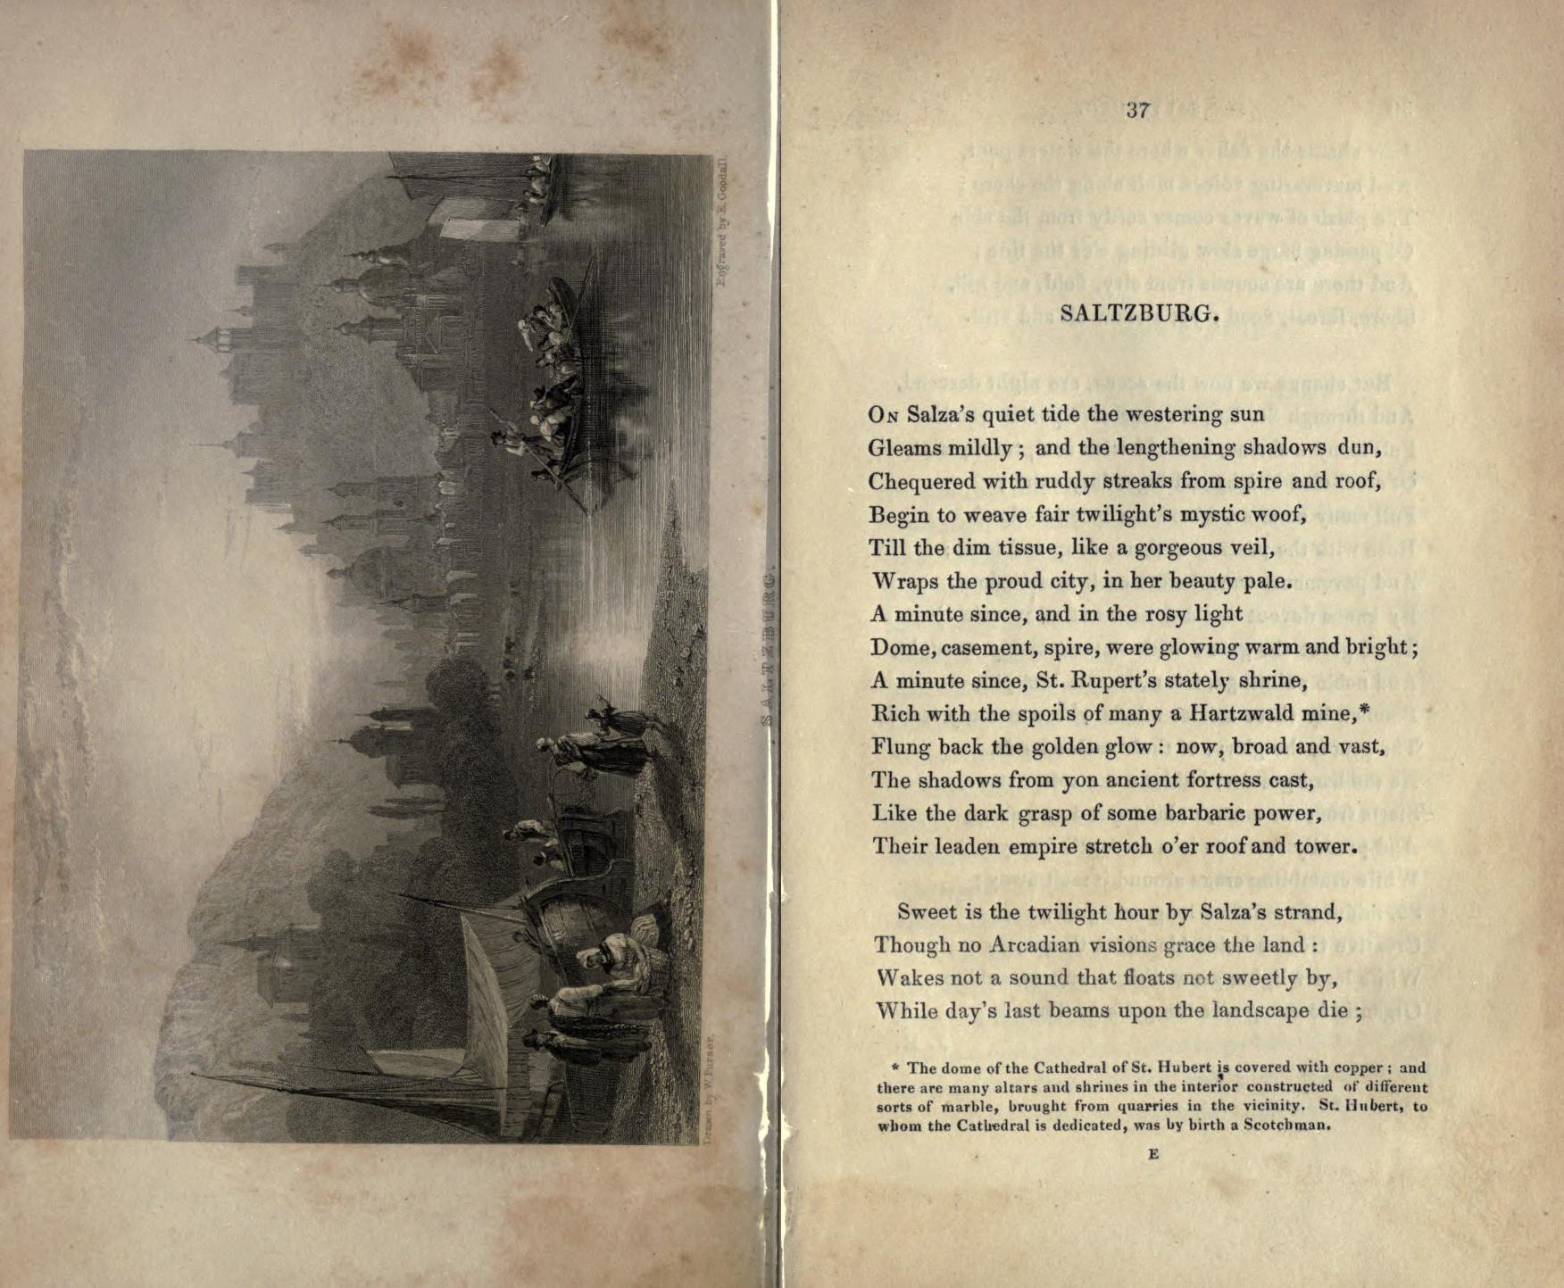

Slide 15
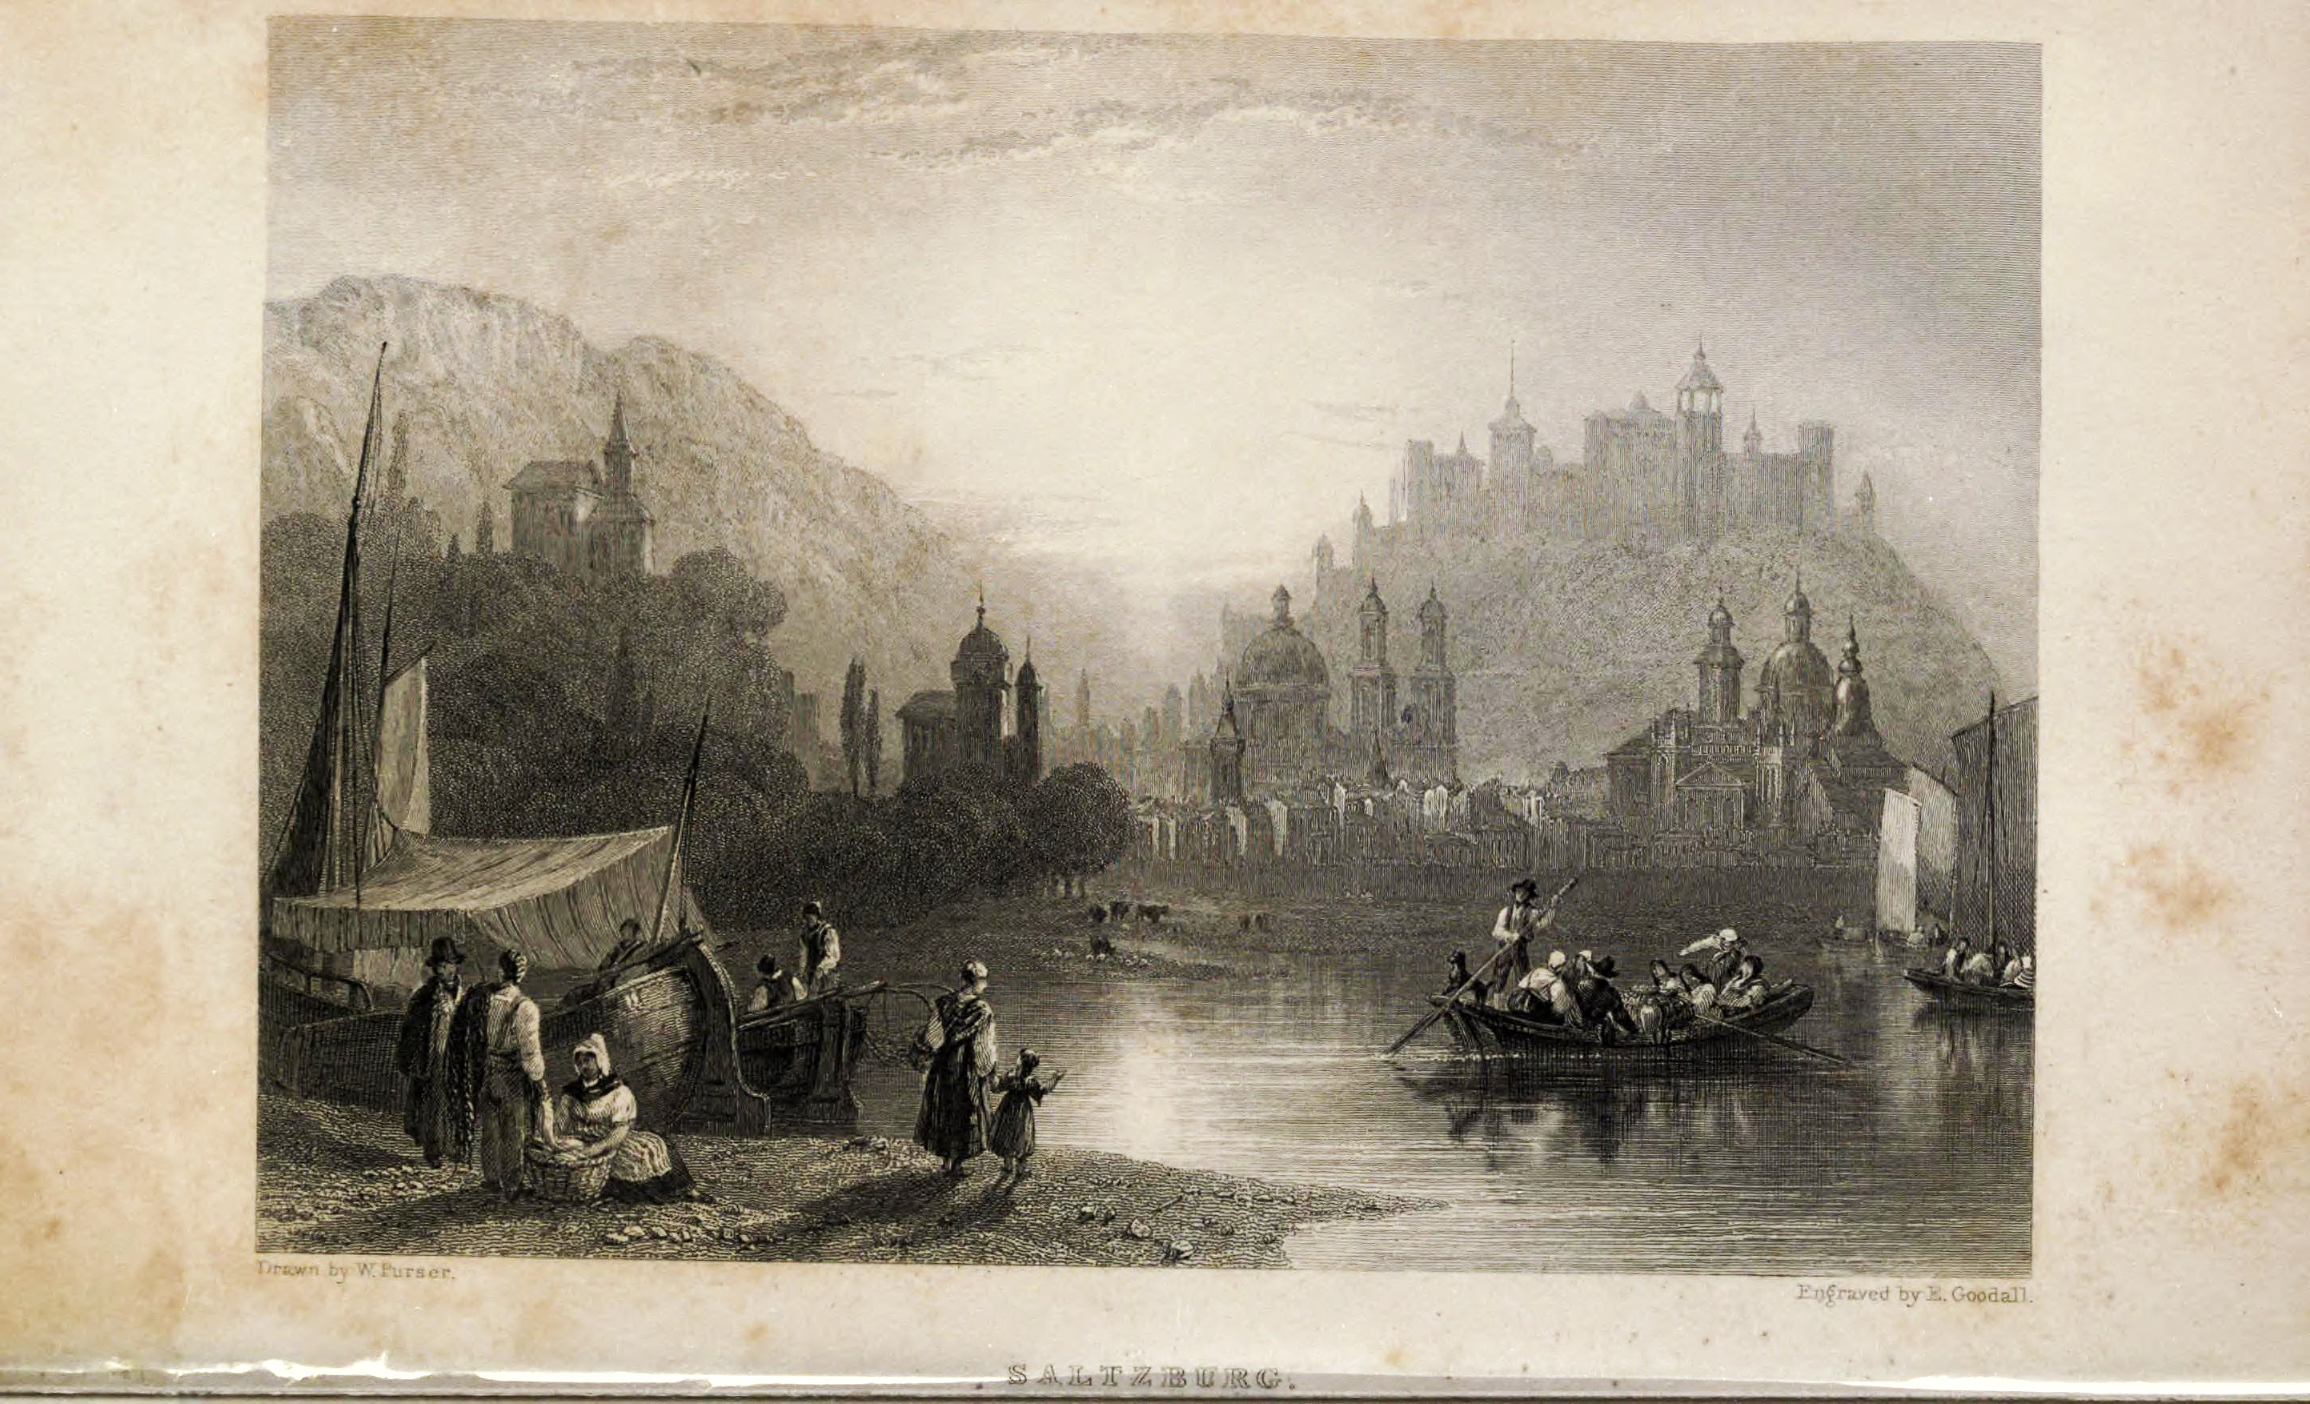
“Saltzburg,” engraving after William Purser, Friendship’s Offering (1835)

Slide 16
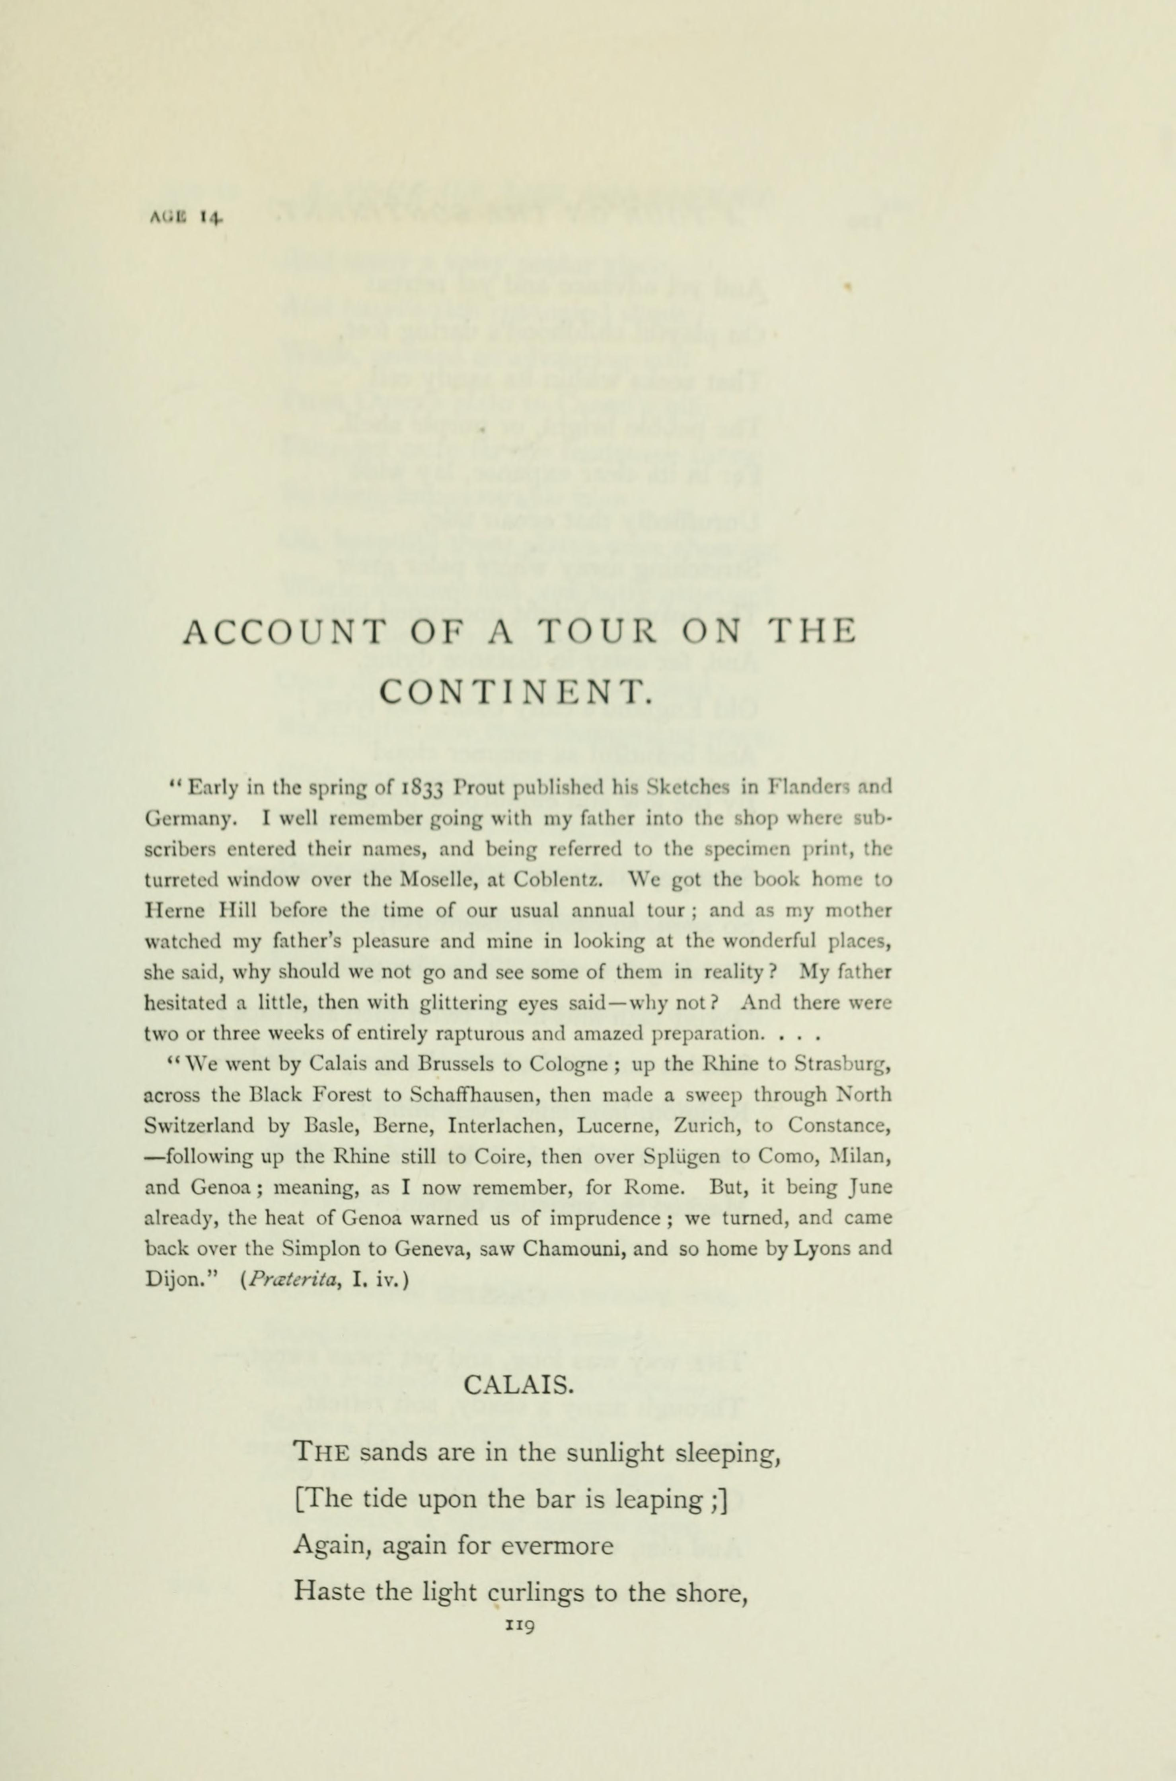
Account of a Tour on the Continent, ed. Collingwood, Poems (1891)

